Slide 1

Air Traffic Flow Management (ATFM)
Rajnish Sharma

Slide 2

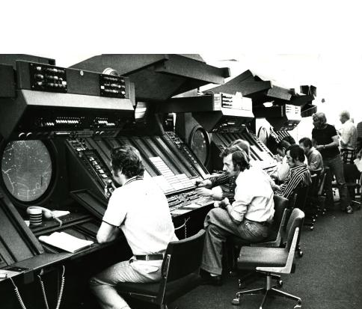
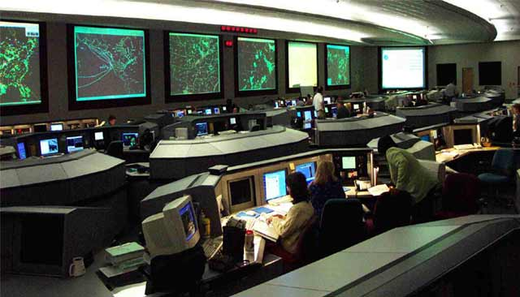
Air Traffic CONTROL
Contents
Introduction
Related Works
Our Approach
Model Formulations
Assumptions
Results and Justifications
Model Limitations and Works Suggestions
Air Traffic MANAGEMENT

Slide 3

Introduction
In 2010, cost of domestic flight delays
$32.9 billion in US
$5.6 billion in Singapore
Half of borne by passengers
Oil price reaches record $98/barrel*
Air traffic doubles by 2020
Aeronautical Information Management
Not well developed
National borders – not traffic flows
Dictate the airspace environment
* November 10, 2011 adapted from WTRG Economics

Slide 4
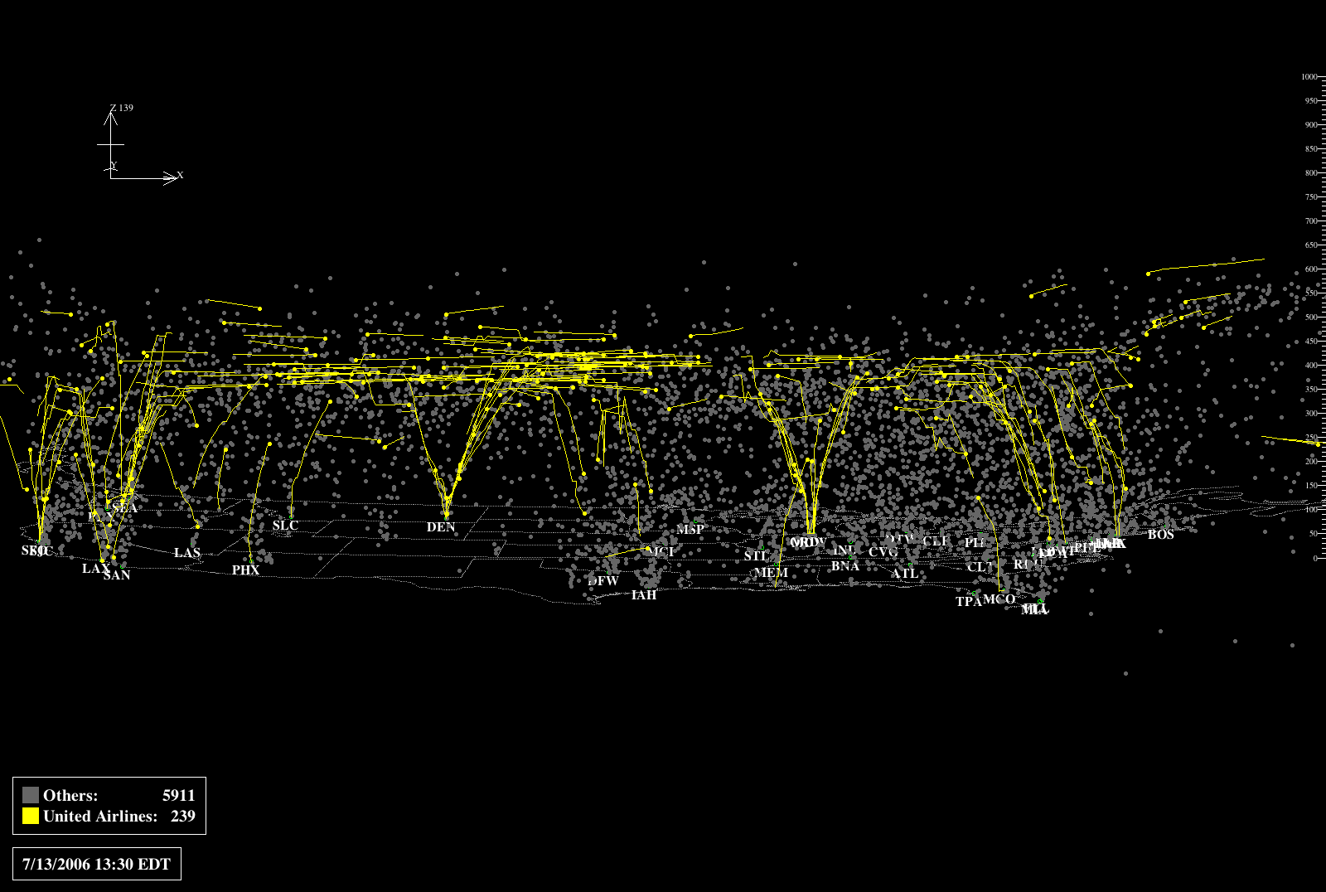

Slide 5
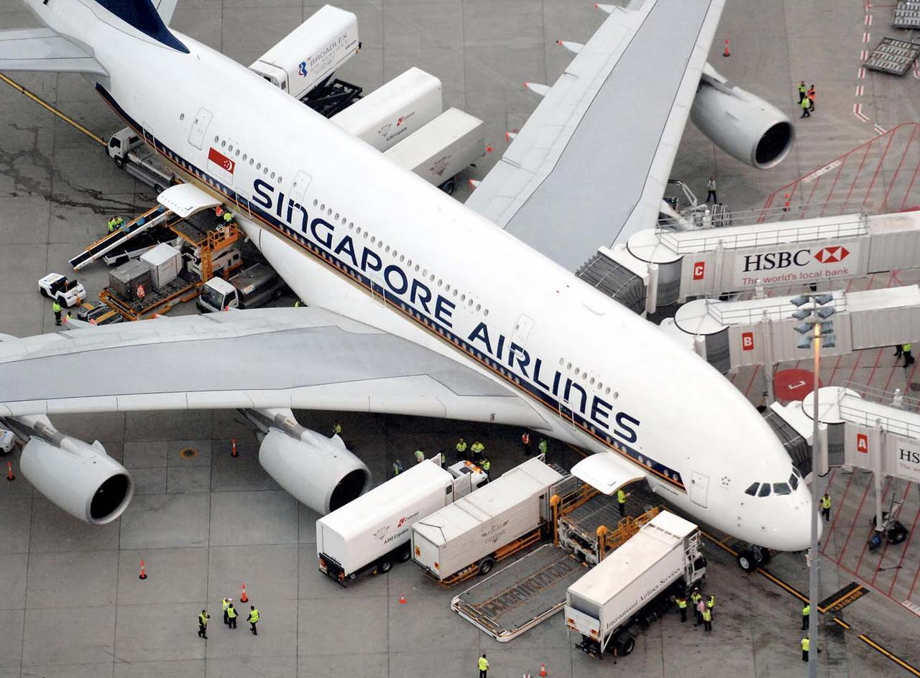
Where are we today….
Better GPS system using satellites
Reduced Vertical Separation Minima (RVSM)
User Preferred Routes (UPR)
Dynamic Airborne Re-route Procedure (DARP)
Flexible Track System (for Oceanic Environment)
However..
Increasing aircrafts and no. of passengers
Makes air traffic flow challenging
Dependence on human-operated system architecture

Slide 6
Related Works
Bertsimas and Stock
ATFM Rerouting Problem (TFMRP)
Time and route assignment problem through dynamic approach
Doan et al.
Deterministic model
Optimize route and flight-level assignment
Trajectory-based ATFM environment
Delahaye and Odoni
Problem of airspace congestion
Stochastic optimization
Using genetic algorithm

Slide 7
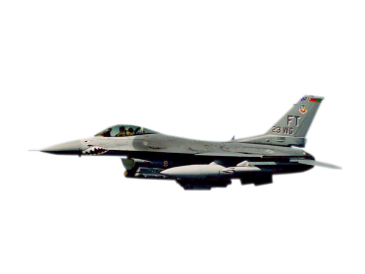
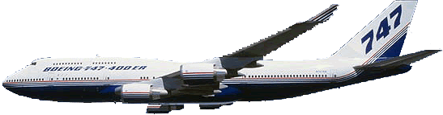
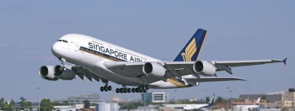


Trajectory Contract for Airspace Access
FIR (1)
FIR (2)
ATC (1)
ATC (2)

Slide 8
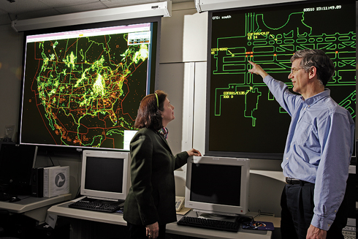
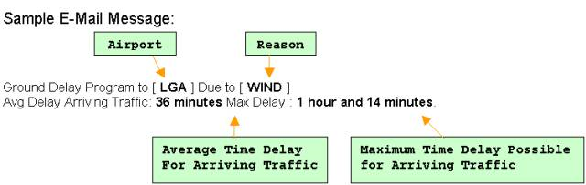
Our Approach To The Problem
Minimization of Operation Cost
Ground Delay
Projected traffic demand exceeds airport's acceptance rate
Fuel, maintenance and crew cost
Implemented to control air traffic volume to airports
Air Delay
Intentional delay in landing
Due to space constraints in destination airport/control sectors

Slide 9
Formulation
Minimize Cost of Delay
Air
Ground
Minimize Cost of Flying
Different trajectories
Values vary with aircraft types
OBJECTIVE
Equality constraints on air and ground at destination and origin airports
Bounds on no. of aircrafts an airport can accommodate
Trajectory allocation constraints
CONSTRAINTS

Slide 10
Model Formulation 1
Minimize
i origin airports
j destination ariports
K aircraft types
L trajectories
t time
Subject to
z_{ij} Binary variable if flight i in trajectory j
r_{l} Delay imposed on connecting flight l
y_{ijkp} Binary variable if flight i in trajectory j at airport k in time period p

Slide 11
Model Formulation 2
Minimize
Subject to
i origin airports
j destination airports
l trajectories
K types of aircrafts
t time
z1_{ijt} fraction of the delay time in ground
1- z1_{ijt} fraction of the delay time in air
r_{ijt} total delay time
p_{ijl} travelling time through the trajectory

Slide 12
Final Model Formulation
Minimize
i Flights
j Trajectories
k Airports
l Connecting flights
p Time period
Subject to
x_{ij} Binary variable if flight i following trajectory j
y_{ijkp} Binary variable if flight i following trajectory j at airport k in time period p
r_{l} Delay imposed on connecting flight l
C_{g} Delay cost of connected flights
a_{Ij} Arrival time of flight f by trajectory j

Slide 13
Sets and Variables for Model
i : Set of considered flights. Flights are determined with its origin-destination & arrival time. (20 aircrafts)
j : Set of feasible trajectories for flights (3 for each flights)
r : set of capacitated structure (sectors and airports) ( 3 sectors/airports)
l: set of connected flights
p: set of periods (12 periods of 2hrs each)
C_{(I,j)} : total cost of trajectory j for flight i. This is two-fold and is made of fuel consumption and direct delay cost.
C_{g}: delay cost of connected flights
C_{(r,p)} : Capacity of capacited structure (10 for each capacited structure)
Y_{(I,j,r,p)}: 1, if flight is flying trajectory j enters capacited structure r during period p;
0 :otherwise
a_{(I,j)}: arrival time of flight f by trajectory j
t_{(i,l)}: minimum turnover time between flight I arrival and connected flight l departure,
d(l) : planned departure time for connected flight l
X_{(I,j)}: 1, if trajectory j is assigned to flight I;
0 otherwise

Slide 14
Assumptions
20 flights are entering the Control Sectors at the same time.
Control sectors are strictly circular with CS1 at the Periphery and CS10 at the airport
We are only considering arrival of flights at the airport and the consequent delay imposed on the connected flight.
We are not considering any airborne delays explicitly due to changing weather conditions and emergencies.
We have assumed the arrival times, departure times, turnover times, and operation and delay costs although approximately following the relative weightages.
We assume that no breakdowns and no disruption of flights take place and every flight is given permission to fly or land.

Slide 15
Optimizing Tools
We have used GAMSIDE (Licensed Software) to optimize the air-traffic flow formulation. The Solver used is Baron-MINLP
Following are the model statistics:
Parameter | Value
Execution Time | 0.733 sec
Generation Time | 0.733 Sec
Single Equations | 2391
Discrete Variables | 6600
Code Length | 18100
Non-Zero Elements | 19570

Slide 16
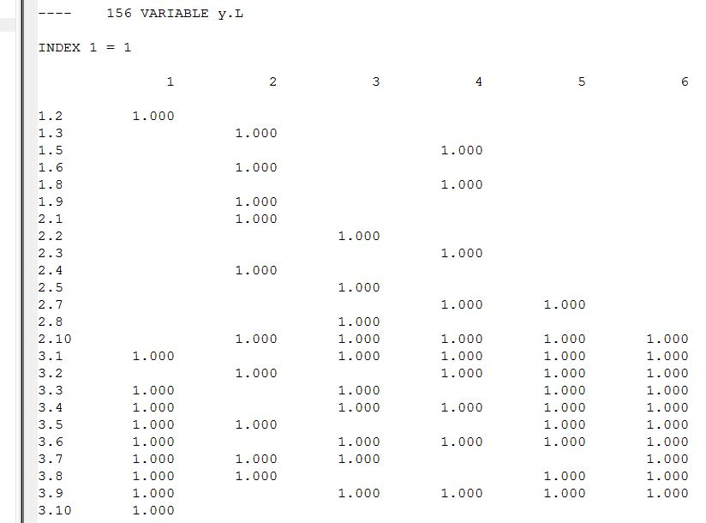
Results
Flight positions at different time intervals for flight1.
Similar data for each of 20 flights considered

Slide 17
Results and Justifications
.
FLIGHT | CAPACITATED STRUCTURE (SECTOR/AIRPORT)
 | 1 | 2 | 3 | 4 | 5 | 6 | 7 | 8 | 9 | 10
3K683
QF4228
SQ241
TR2102
MI332
FLIGHT | CAPACITATED STRUCTURE (SECTOR/AIRPORT)
 | 1 | 2 | 3 | 4 | 5 | 6 | 7 | 8 | 9 | 10
3K511
QF4210
UL316
MI962
SQ5162

Slide 18
Results and Justifications

Slide 19
Model Limitations and Future Work Suggestions
Unavoidable delay like weather conditions or political problems should be taken into consideration
Robust Optimization because of 1% relative excess cost in planning for large fleets translates into 4% to 8% in operations
Stochastic vehicle routing
Integrated optimization with aircrafts and ground staffs
Predictive planning

Slide 20
References
Zenios, S.A. (1989).Network based models for air-traffic control. Wharton School of business.
Nogami,J., Nakasuka,S. and Tanabe,T. (1996). Real-time decision support for air traffic management, utilizing machine. Department of Aeronautics. University of Tokyo.
D. Sloan. (2008). The Air Traﬃc Flow Management Problem: An Integer Optimization Approach Bertsimas. School of management. MIT.

Slide 21

Thanks!

